Slide 1
Using Predictive Modelling to Assess Water Safety
Yash Jain, Ting Hsu, Yayuan Yuan, Yuan Liu

Slide 2
Dataset
3276 Samples
Features:
pH
Hardness
Solids
Chloramines
Sulfate
Conductivity
Organic Carbon
Trihalomethanes
Turbidity

Slide 3
Missing Data
pH | 491
Hardness | 0
Solids | 0
Chloramines | 0
Sulfate | 781
Conductivity | 0
Organic Carbon | 0
Trihalomethanes | 162
Turbidity | 0
Potability | 0
1065 Samples

Slide 4
Potability
Binary Classification
Potable ~ 0.39
Not Potable ~ 0.61

Slide 5
Preprocessing
Mean Imputation
Standard Scaling

Slide 6
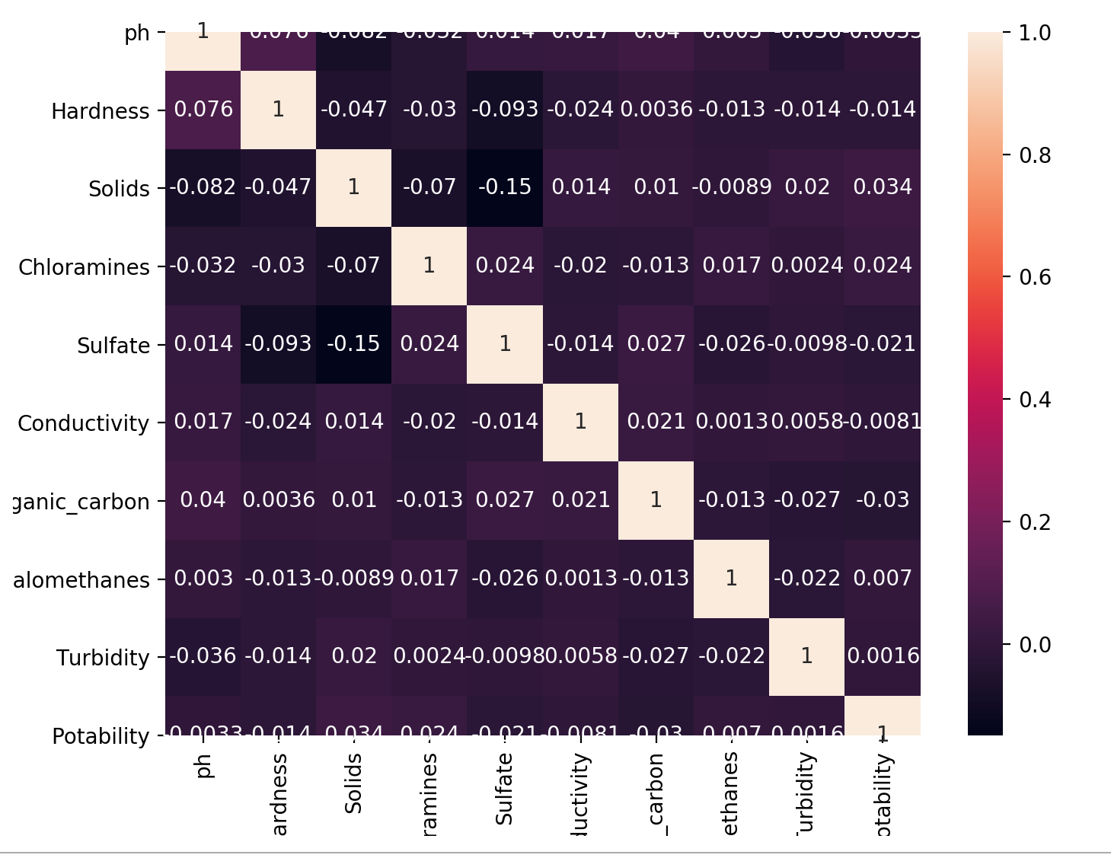
Heatmap

Slide 7
Algorithms
KNN
SVM
Logistic Regression

Slide 8
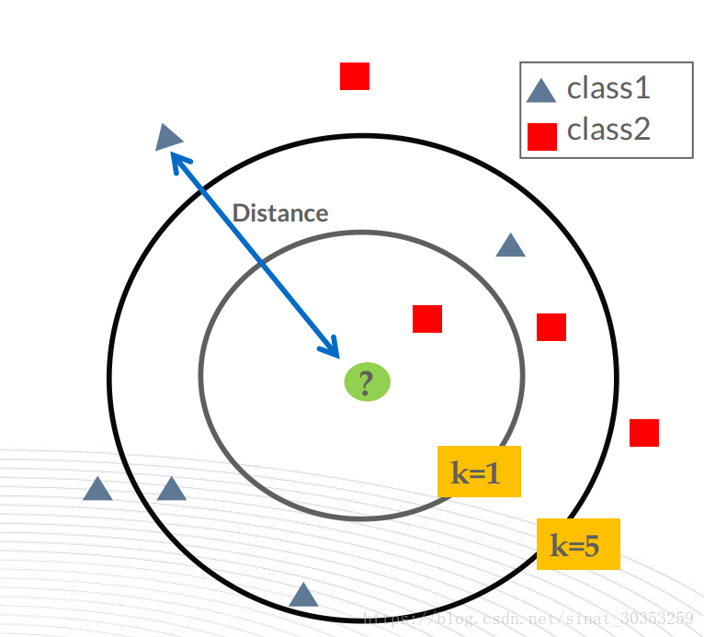
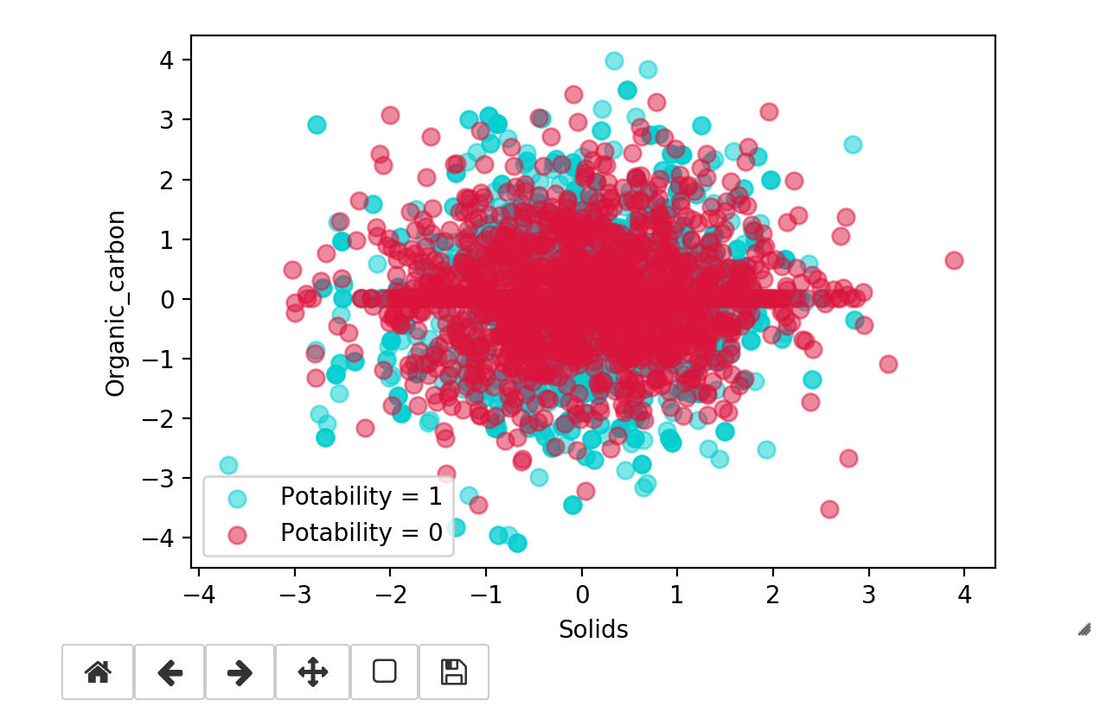
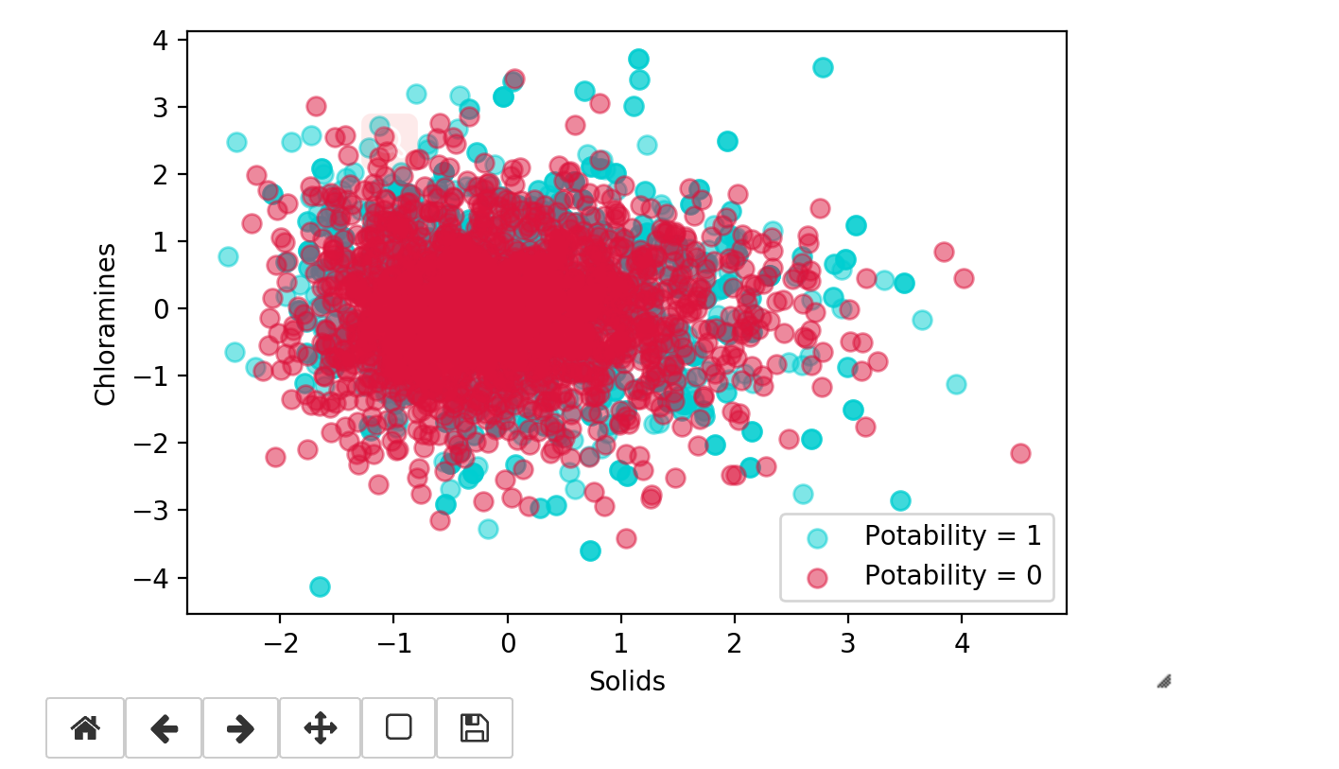
K-Nearest Neighbor

Slide 9
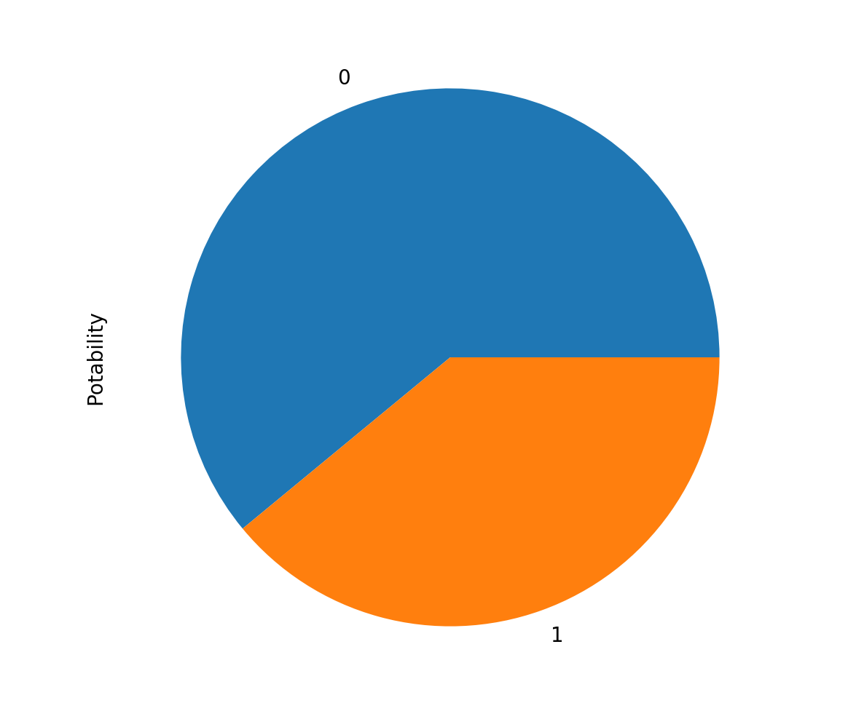


KNN is susceptible to class imbalance

Slide 10
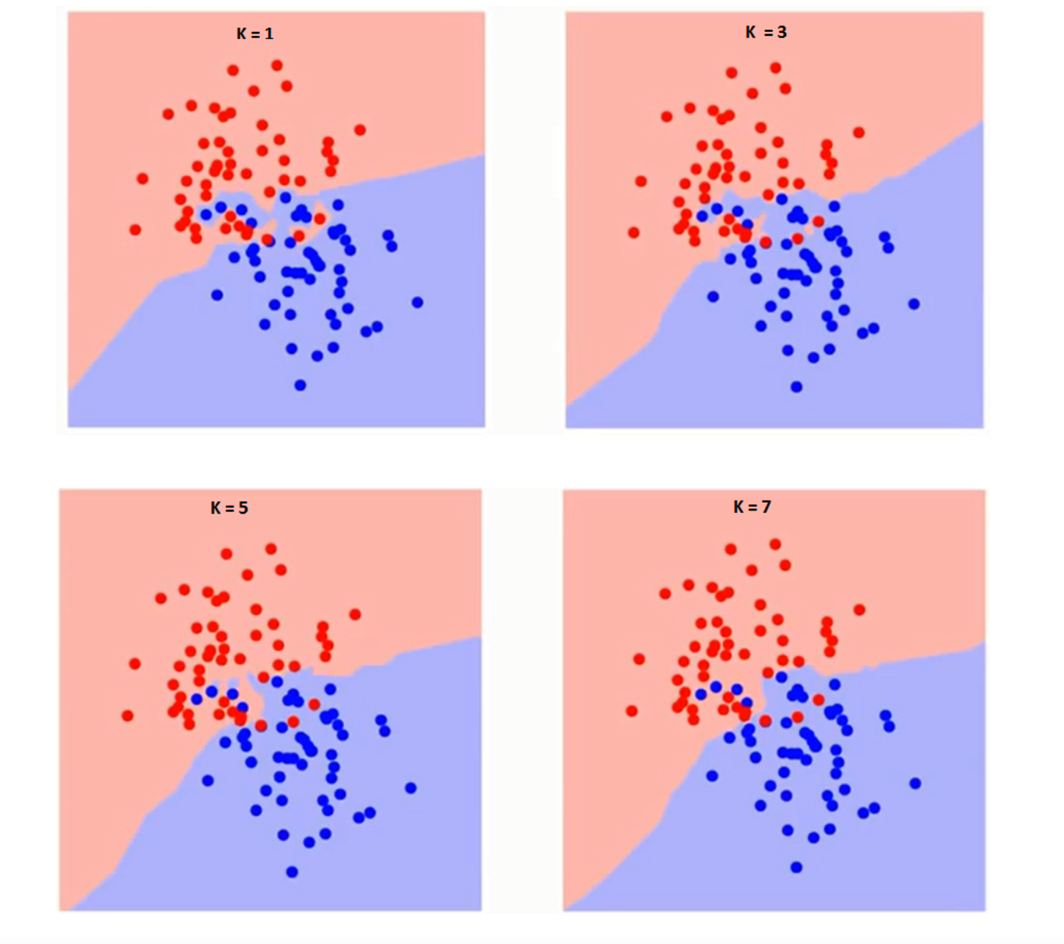
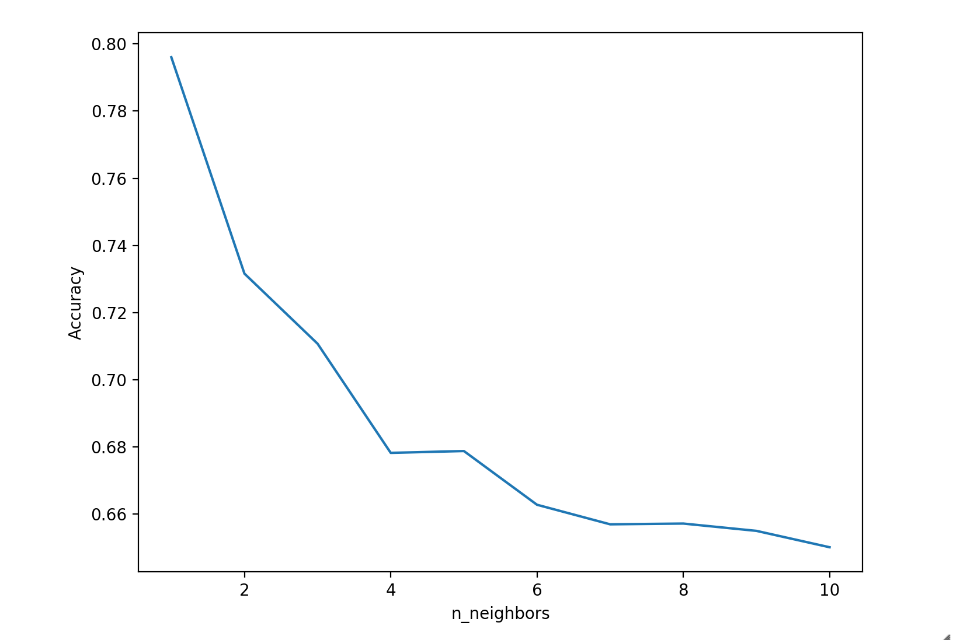
How K affect the algorithm

Slide 11
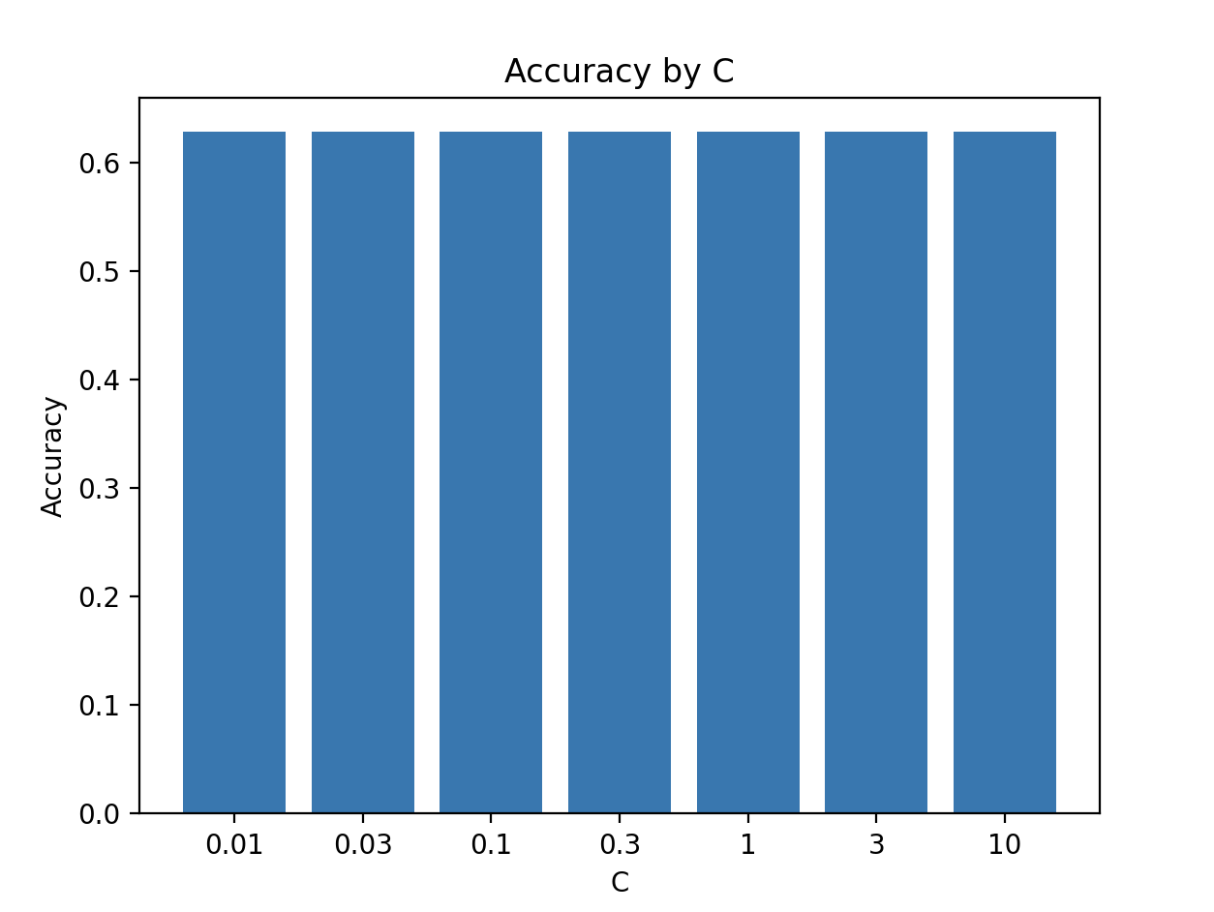
SVM -- linear
[[412 0]
[244 0]]

Slide 12
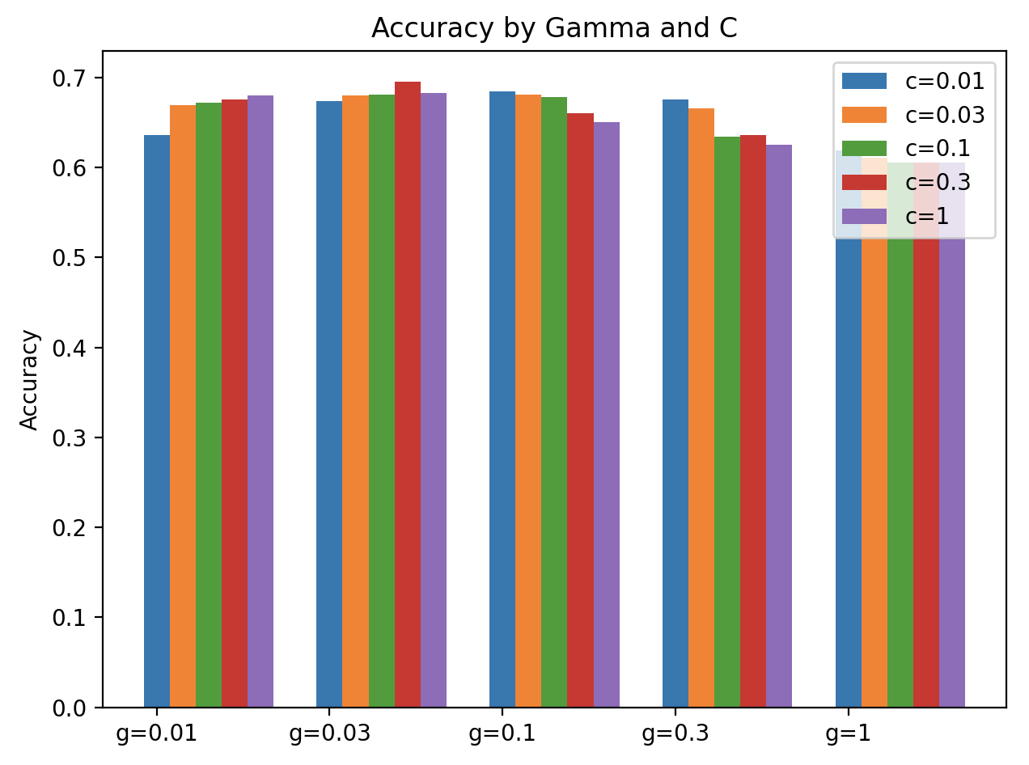
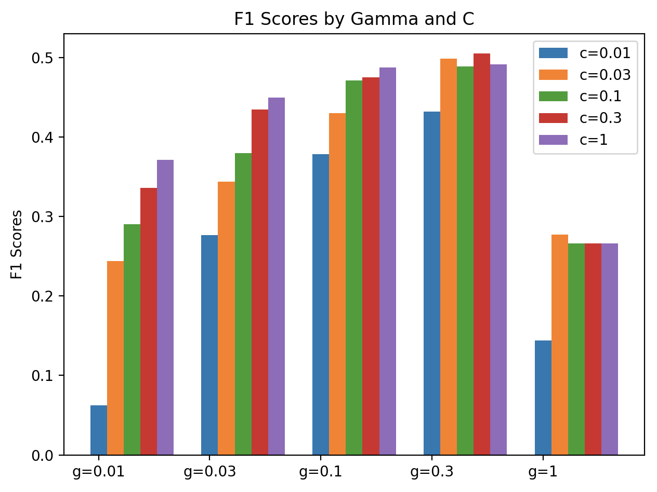
SVM -- rbf

Slide 13
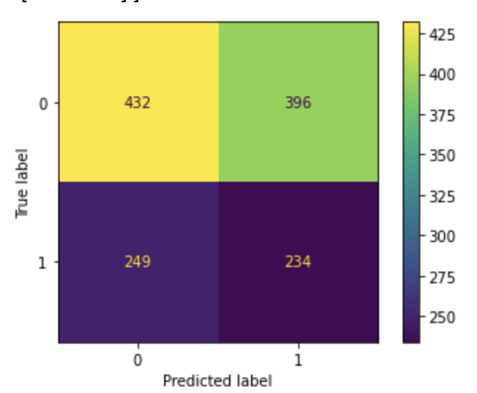
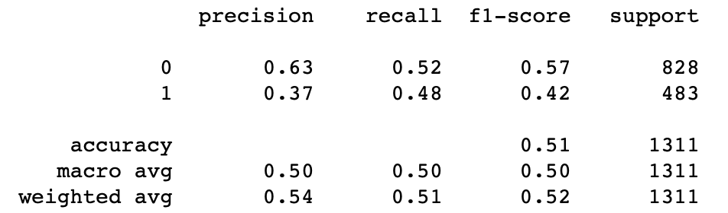
Logistic Regression
Confusion Matrix
Accuracy Score
Notes:
With sklearn Logistic Regression parameter(class_weight=’balanced’)

Slide 14
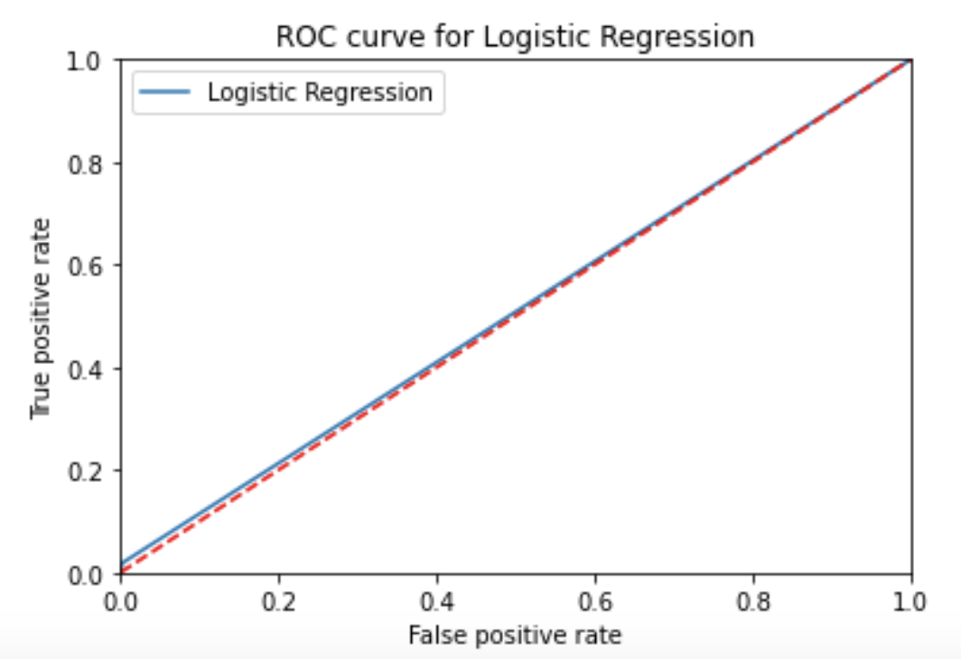
Logistic Regression

